Slide 1
Introduction to Semantic Web and Ontologies
Hasan TÜRKSOY
Compiled, partly based on various online tutorials and presentations, with respect to their authors

Slide 2
Introduction to Semantic Web
Based on tutorials and presentations:
D. Lee, F. Harmelen, M. Arumugam, C. Goble, I. Horrocks, N. F. Noy, D.L. McGuinness, J. Broekstra, M. Klein, S. Decker, D. Fensel, DERI Group, H. Knublauch,
N. Drummond, M. Horridge

Slide 3

History of the Semantic Web
Web was “invented” by Tim Berners-Lee (amongst others), a physicist working at CERN
TBL’s original vision of the Web was much more ambitious than the reality of the existing (syntactic) Web:
TBL (and others) have since been working towards realising this vision, which has become known as the Semantic Web
E.g., article in May 2001 issue of Scientific American…
“... a goal of the Web was that, if the interaction between person and hypertext could be so intuitive that the machine-readable information space gave an accurate representation of the state of people's thoughts, interactions, and work patterns, then machine analysis could become a very powerful management tool, seeing patterns in our work and facilitating our working together through the typical problems which beset the management of large organizations.”
Notes:
[1,8]

Slide 4
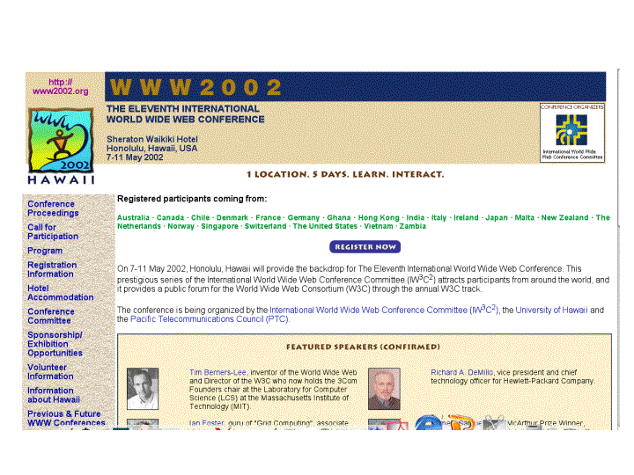
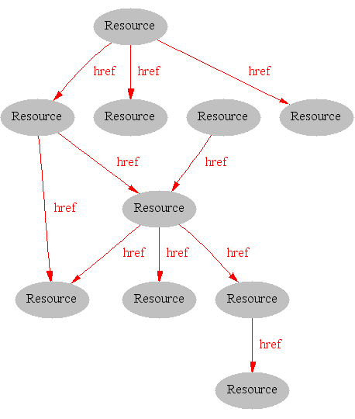
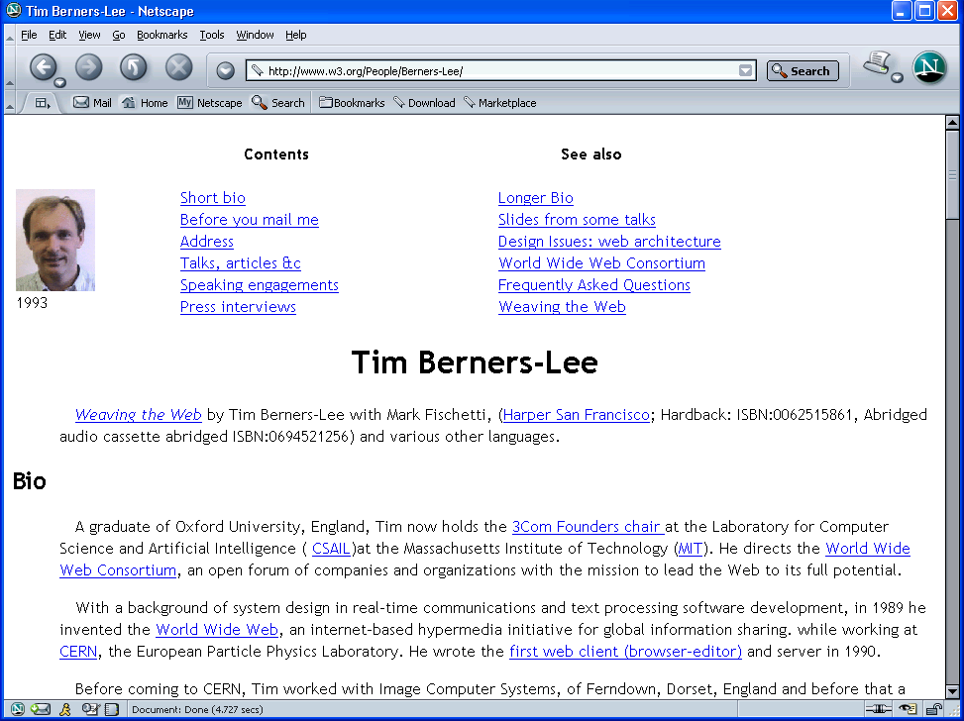
Where we are Today: the Syntactic Web
[Hendler & Miller 02]
Notes:
[1,8]

Slide 5
The Syntactic Web is…
A hypermedia, a digital library
A library of documents called (web pages) interconnected by a hypermedia of links
A database, an application platform
A common portal to applications accessible through web pages, and presenting their results as web pages
A platform for multimedia
BBC Radio 4 anywhere in the world! Terminator 3 trailers!
A naming scheme
Unique identity for those documents
A place where computers do the presentation (easy) and people do the linking and interpreting (hard).
Why not get computers to do more of the hard work?
[Goble 03]
Notes:
[1,8]

Slide 6
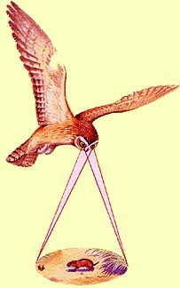
Impossible (?) using the Syntactic Web…
Complex queries involving background knowledge
Find information about “animals that use sonar but are not either bats or dolphins”
Locating information in data repositories
Travel enquiries
Prices of goods and services
Results of human genome experiments
Finding and using “web services”
Visualize surface interactions between two proteins
Delegating complex tasks to web “agents”
Book me a holiday next weekend somewhere warm, not too far away, and where they speak French or English
, e.g., Barn Owl

Slide 7
What is the Problem?
Consider a typical web page:
Markup consists of:
rendering information (e.g., font size and colour)
Hyper-links to related content
Semantic content is accessible to humans but not (easily) to computers…
Notes:
[1,8]

Slide 8
What information can we see…
WWW2002
The eleventh international world wide web conference
Sheraton waikiki hotel
Honolulu, hawaii, USA
7-11 may 2002
1 location 5 days learn interact
Registered participants coming from
australia, canada, chile denmark, france, germany, ghana, hong kong, india, ireland, italy, japan, malta, new zealand, the netherlands, norway, singapore, switzerland, the united kingdom, the united states, vietnam, zaire
Register now
On the 7th May Honolulu will provide the backdrop of the eleventh international world wide web conference. This prestigious event …
Speakers confirmed
Tim berners-lee
Tim is the well known inventor of the Web, …
Ian Foster
Ian is the pioneer of the Grid, the next generation internet …
Notes:
[1]

Slide 9
What information can a machine see…
WWW2002
The eleventh international world wide web conference
Sheraton waikiki hotel
Honolulu, hawaii, USA
7-11 may 2002
1 location 5 days learn interact
Registered participants coming from
australia, canada, chile denmark, france, germany, ghana, hong kong, india, ireland, italy, japan, malta, new zealand, the netherlands, norway, singapore, switzerland, the united kingdom, the united states, vietnam, zaire
Register now
On the 7th May Honolulu will provide the backdrop of the eleventh international world wide web conference. This prestigious event …
Speakers confirmed
Tim berners-lee
Tim is the well known inventor of the Web, …
Ian Foster
Ian is the pioneer of the Grid, the next generation internet …
Notes:
[1]

Slide 10
Solution: XML markup with “meaningful” tags?
<name>WWW2002
The eleventh international world wide webcon</name>
<location>Sheraton waikiki hotel
Honolulu, hawaii, USA</location>
<date>7-11 may 2002</date>
<slogan>1 location 5 days learn interact</slogan>
<participants>Registered participants coming from
australia, canada, chile denmark, france, germany, ghana, hong kong, india, ireland, italy, japan, malta, new zealand, the netherlands, norway, singapore, switzerland, the united kingdom, the united states, vietnam, zaire</participants>
<introduction>Register now
On the 7th May Honolulu will provide the backdrop of the eleventh international world wide web conference. This prestigious event …
Speakers confirmed</introduction>
<speaker>Tim berners-lee</speaker>
<bio>Tim is the well known inventor of the Web,</bio>…
Notes:
[1]

Slide 11
But What About…
<conf>WWW2002
The eleventh international world wide webcon</conf>
<place>Sheraton waikiki hotel
Honolulu, hawaii, USA</place>
<date>7-11 may 2002</date>
<slogan>1 location 5 days learn interact</slogan>
<participants>Registered participants coming from
australia, canada, chile denmark, france, germany, ghana, hong kong, india, ireland, italy, japan, malta, new zealand, the netherlands, norway, singapore, switzerland, the united kingdom, the united states, vietnam, zaire</participants>
<introduction>Register now
On the 7th May Honolulu will provide the backdrop of the eleventh international world wide web conference. This prestigious event …
Speakers confirmed</introduction>
<speaker>Tim berners-lee</speaker>
<bio>Tim is the well known inventor of the Web,…

Slide 12
Still the Machine only sees…
<name>WWW2002
The eleventh international world wide webc</name>
<location>Sheraton waikiki hotel
Honolulu, hawaii, USA</location>
<date>7-11 may 2002</date>
<slogan>1 location 5 days learn interact</slogan>
<participants>Registered participants coming from
australia, canada, chile denmark, france, germany, ghana, hong kong, india, ireland, italy, japan, malta, new zealand, the netherlands, norway, singapore, switzerland, the united kingdom, the united states, vietnam, zaire</participants>
<introduction>Register now
On the 7th May Honolulu will provide the backdrop of the eleventh international world wide web conference. This prestigious event …
Speakers confirmed</introduction>
<speaker>Tim berners-lee</speaker>
<bio>Tim is the well known inventor of the W</bio>
<speaker>Ian Foster</speaker>
<bio>Ian is the pioneer of the Grid, the ne</bio>
Notes:
[1], son 4 tane için için [2]’ye de bakılabilir...

Slide 13
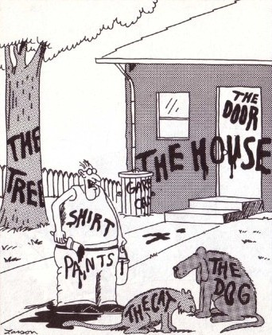
What is the (Proposed) Solution?
Now... that should clear up a few things around here
Notes:
NL annotations (possibly with rendering annotation) already associated with images (only way google can find them)
Augment NL with semantic annotation.

Slide 14
Need to Add “Semantics”
External agreement on meaning of annotations
Agree on the meaning of a set of annotation tags
E.g., Dublin Core
Problems with this approach
Limited flexibility and extensibility
Limited number of things can be expressed
Use Ontologies to specify meaning of annotations
Agree on language used to describe meaning
Ontologies provide a vocabulary of terms
New terms can be formed by combining existing ones
Meaning (semantics) of such terms is formally specified
Can also specify relationships between terms in multiple ontologies
Notes:
[1,8]
Big Apple is a large fruit or a city? [8]

Slide 15
Dublin Core
A set of fifteen basic properties for describing generalised Web resources
ISO Standard 15836-2003 (February 2003): http://www.niso.org/international/SC4/n515.pdf
The Dublin Core Metadata Initiative is an open forum engaged in the development of interoperable online metadata standards that support a broad range of purposes and business models.
http://dublincore.org/
Notes:
[3]

Slide 16
Dublin Core (15 basic properties):
Type
Format
Identifier
Source
Language
Relation
Coverage
Rights
Title
Creator
Subject
Description
Publisher
Contributor
Date
Notes:
[3]

Slide 17
Dublin Core Example
<?xml version="1.0"?>
<rdf:RDF xmlns:rdf=“http://www.w3.org/1999/02/22-rdf-syntax-ns#”
xmlns:dc="http://purl.org/dc/elements/1.0/">
<rdf:Description rdf:about="http://www.ukoln.ac.uk/metadata/resources/dc/ datamodel/WD-dc-rdf/">
<dc:title> Guidance on expressing the Dublin Core within the Resource
Description Framework (RDF) </dc:title>
<dc:creator> Eric Miller </dc:creator>
<dc:creator> Paul Miller </dc:creator>
<dc:creator> Dan Brickley </dc:creator>
<dc:subject> Dublin Core; Resource Description Framework; RDF; eXtensible
Markup Language; XML </dc:subject>
<dc:publisher> Dublin Core Metadata Initiative </dc:publisher>
<dc:contributor> Dublin Core Data Model Working Group </dc:contributor>
<dc:date> 1999-07-01 </dc:date>
<dc:format> text/html </dc:format>
<dc:language> en </dc:language>
</rdf:Description>
</rdf:RDF>
Notes:
[3]

Slide 18


Semantic Web basics...
RDF:
stands for Resource Description Framework
is a W3C standard, which provides tool to describe Web resources
provides interoperability between applications that exchange machine-understandable information
RDF Schema:
is a W3C standard which defines vocabulary for RDF
organizes this vocabulary in a typed hierarchy (Class, Property, type, subClassOf, subPropertyOf, range, domain)
capable to explicitly declare semantic relations between vocabulary terms
Notes:
[3,4]

Slide 19

RDF – Semantic Web over Web Resources
John
Director
has_homepage
has_job
Ontology
to_be_in_love_with
has_job
has_homepage
Secretary
Mary
Notes:
[3]

Slide 20
The RDF Data Model
Statements are <subject, predicate, object> triples:
Can be represented using XML serialisation, e.g.:
<Ian,hasColleague,Uli>
Statements describe properties of resources
All things (including properties) being described by RDF expressions are called resources
A resource is a URI representing a (class of) object(s):
a document, a picture, a paragraph on the Web;
http://www.cs.man.ac.uk/index.html
a book in the library, a real person (?)
isbn://5031-4444-3333
…
Notes:
[4] {
RDF Statement:
Subject of an RDF statement is a resource
Predicate of an RDF statement is a property of a resource
Object of an RDF statement is the value of a property of a resource
}

Slide 21
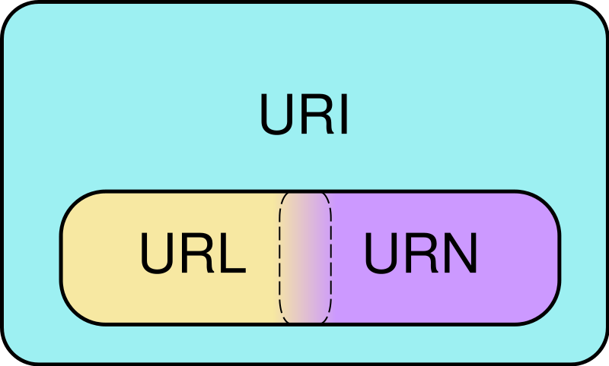
URI
Venn diagram of Uniform Resource Identifier (URI) scheme categories. Schemes in the URL (locator) and URN (name) categories both function as resource IDs, so URL and URN are subsets of URI. They are also, generally, disjoint sets. However, many schemes can't be categorized as strictly one or the other, because all URIs can be treated as names, and some schemes embody aspects of both categories – or neither.
http://www.somedomain.com/some/path/to/file#fragmentID
Notes:
[3]

Slide 22
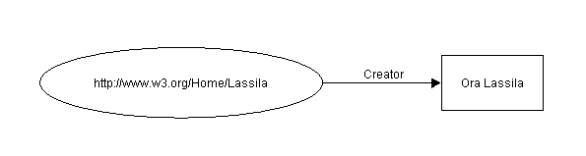
Example of RDF Statement
Ora Lassila is the creator of the resource http://www.w3.org/Home/Lassila.
Subject (resource)
http://www.w3.org/Home/Lassila
Predicate (property)
Creator
Object (literal)
“Ora Lassila”
Notes:
[3] -> kendi örneğini geliştir (Hasan hasColleague Tolga)

Slide 23
RDF Example (serialization syntax)
Ora Lassila is the creator of the resource http://www.w3.org/Home/Lassila.
<rdf:RDF>
<rdf:Description about=
"http://www.w3.org/Home/Lassila">
<s:Creator>Ora Lassila</s:Creator>
</rdf:Description>
</rdf:RDF>
's' is a specific namespace prefix, e.g.
xmlns:s="http://description.org/schema/"
Notes:
[3]

Slide 24
What is RDFS ?
RDF Schema
Defines vocabulary for RDF
Organizes this vocabulary in a typed hierarchy (Class, subClassOf, type, Property, subPropertyOf)
Rich, web-based publication format for declaring semantics (XML for exchange)
Capability to explicitly declare semantic relations between vocabulary terms
Notes:
[3]
[4] {
RDF gives a formalism for meta data annotation, and a way to write it down in XML, but it does not give any special meaning to vocabulary such as subClassOf or type
Interpretation is an arbitrary binary relation
I.e., <Person,subClassOf,Animal> has no special meaning
RDF Schema defines “schema vocabulary” that supports definition of ontologies
gives “extra meaning” to particular RDF predicates and resources (such as subClasOf)
this “extra meaning”, or semantics, specifies how a term should be interpreted
}

Slide 25
RDF Schema
Semantic network on the Web
Nodes are identified by URIs
rdfs:Class
rdfs:Property
rdfs:subClassOf
Notes:
[3]

Slide 26
RDFS Examples
RDF Schema terms (just a few examples):
Class
Property
type
subClassOf
range
domain
These terms are the RDF Schema building blocks (constructors) used to create vocabularies:
<Person,type,Class>
<hasColleague,type,Property>
<Professor,subClassOf,Person>
<Carole,type,Professor>
<hasColleague,range,Person>
<hasColleague,domain,Person>
Notes:
[4] + class diagram ve owl kodu ekle

Slide 27
Problems with RDFS
RDFS too weak to describe resources in sufficient detail
No localised range and domain constraints
Can’t say that the range of hasChild is person when applied to persons and elephant when applied to elephants
No existence/cardinality constraints
Can’t say that all instances of person have a mother that is also a person, or that persons have exactly 2 parents
No transitive, inverse or symmetrical properties
Can’t say that isPartOf is a transitive property, that hasPart is the inverse of isPartOf or that touches is symmetrical
…
Difficult to provide reasoning support
No “native” reasoners for non-standard semantics
May be possible to reason via FO axiomatisation
Notes:
[4]

Slide 28
Where to look next
RDF: http://www.w3.org/RDF/
RDF Schema: http://www.w3.org/TR/rdf-schema/
Notes:
[3]

Slide 29
Mola...
Next: Ontologies...

